Slide 1

AceOS
Asset, Compliance & Equipment
Operations System
Object Oriented Programming | Relational Database Management Systems
Smit Hitnalli • 2502051938 • Section N3
Notes:
Timing: 25 seconds. Good morning. I am Smit Hitnalli, registration number 2502051938, section N3. My project is AceOS, the Asset, Compliance & Equipment Operations System. It is a local Java application for campus equipment faults and maintenance. I will first show one repair example, then explain the object-oriented design and the relational database behind it. This same application is the basis of both subject submissions.
Sources: AceOS v2.0.0, https://github.com/SmitHitnalli/aceos ; README.md; docs/college-scope.md; docs/oop-design.md; docs/data-dictionary.md; docs/transactions.md; docs/verification.md. Source references below are repository-relative. Screenshots are controlled UI-check fixtures, not live institutional data.

Slide 2
When classroom equipment fails
An AC stops cooling.
What happens next?
01
Who reported the problem?
02
Who is responsible for fixing it?
The fault, assignment and final acceptance
need one traceable workflow.
03
Who confirms the repair is acceptable?
02
Notes:
Timing: 40 seconds. Consider an air conditioner in a classroom that is not cooling. This is an illustrative example matching the type of asset represented in the project fixtures. Reporting the fault is only the beginning. Someone has to decide whether it should be accepted, assign the work and establish whether the repair is actually satisfactory. Without connected records, those decisions can become disconnected messages. The three questions on this slide are the operational problem AceOS addresses. I am not claiming measured delays or savings.
Sources: AceOS v2.0.0, https://github.com/SmitHitnalli/aceos ; README.md; docs/college-scope.md; docs/oop-design.md; docs/data-dictionary.md; docs/transactions.md; docs/verification.md. Source references below are repository-relative. Screenshots are controlled UI-check fixtures, not live institutional data.

Slide 3
One application, three responsibilities
REQUESTER
TECHNICIAN
ADMINISTRATOR
Report the fault
Perform the repair
Review and verify
Track own complaint
and add comments
Submit work and
correct returned repairs
Assign technicians and
accept the final result
Also supported: inspections, safety holds, preventive schedules and account management
03
Notes:
Timing: 45 seconds. AceOS connects the asset register to complaints, repair work, inspections and preventive schedules. The requester reports a problem and follows their own complaint. The technician handles assigned work and can submit a correction when a repair is returned. The administrator reviews, assigns and verifies work and manages operational records. The permission checks are in services, so they are more than visibility rules for buttons. The application is local: JavaFX provides the interface and MySQL stores durable records.
Sources: AceOS v2.0.0, https://github.com/SmitHitnalli/aceos ; README.md; docs/college-scope.md; docs/oop-design.md; docs/data-dictionary.md; docs/transactions.md; docs/verification.md. Source references below are repository-relative. Screenshots are controlled UI-check fixtures, not live institutional data.

Slide 4
A fault becomes a verified repair
1
2
3
4
5
Report
→
Review
→
Assign
→
Repair
→
Verify
Requester
Administrator
Administrator
Technician
Administrator
If work is returned:
Reason → correction → new submission → fresh review
04
Notes:
Timing: 60 seconds. In our example, the requester reports the AC fault. An administrator accepts the complaint and assigns a technician. The technician starts and completes the repair. The administrator then reviews the submitted evidence and verifies it. Verification resolves that linked complaint. Completion and verification are deliberately separate: finishing work is the technician’s statement, while acceptance belongs to the administrator. If the result is unsatisfactory, the administrator returns it with a reason. The assigned technician submits a new correction, preserving earlier evidence. This is the main example used in both the OOP and database sections.
Sources: AceOS v2.0.0, https://github.com/SmitHitnalli/aceos ; README.md; docs/college-scope.md; docs/oop-design.md; docs/data-dictionary.md; docs/transactions.md; docs/verification.md. Source references below are repository-relative. Screenshots are controlled UI-check fixtures, not live institutional data.

Slide 5
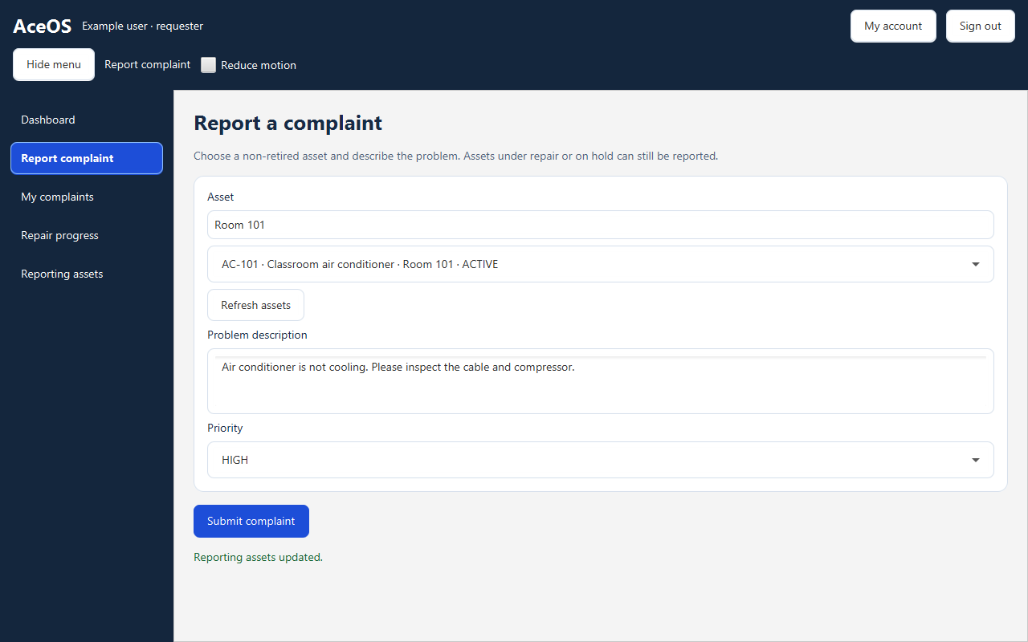
1. Report the fault
05
Notes:
Timing: approximately 20 seconds. Show the reporting form. The requester selects the asset, describes the fault and chooses a priority before submitting. This fixture shows the completed form before submission; it does not show a newly saved complaint. Connect it to step 1 on the workflow slide. Source: target/ui-checks/presentation-report-full-shell-1280.png.
Sources: AceOS v2.0.0, https://github.com/SmitHitnalli/aceos ; README.md; docs/college-scope.md; docs/oop-design.md; docs/data-dictionary.md; docs/transactions.md; docs/verification.md. Source references below are repository-relative. Screenshots are controlled UI-check fixtures, not live institutional data.

Slide 6
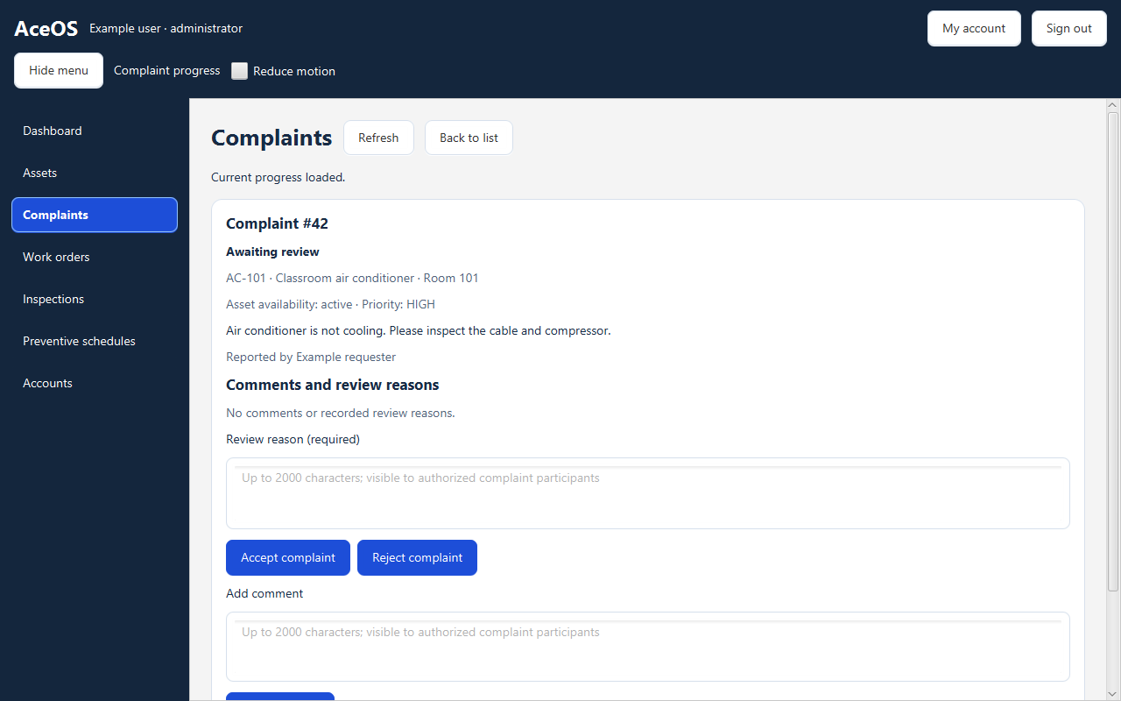
2. Review the complaint
06
Notes:
Timing: approximately 20 seconds. Point to the classroom AC complaint, the required review reason and the Accept complaint / Reject complaint controls. The administrator reviews the request before it becomes assigned repair work. This is step 2 of the workflow. Source: target/ui-checks/phase3-detail-administrator-1280.png.
Sources: AceOS v2.0.0, https://github.com/SmitHitnalli/aceos ; README.md; docs/college-scope.md; docs/oop-design.md; docs/data-dictionary.md; docs/transactions.md; docs/verification.md. Source references below are repository-relative. Screenshots are controlled UI-check fixtures, not live institutional data.

Slide 7
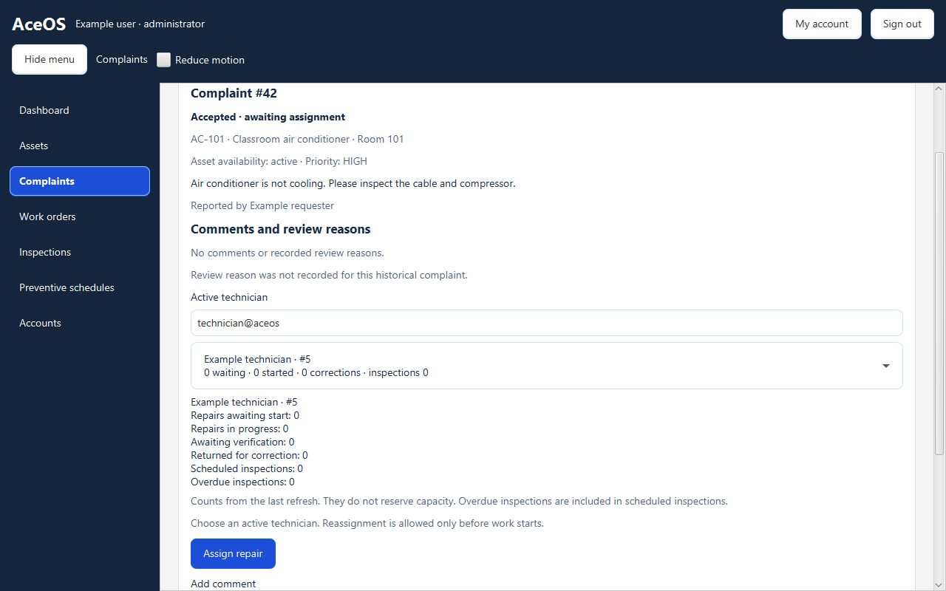
3. Assign a technician
07
Notes:
Timing: approximately 20 seconds. Point to the selected technician, workload information and Assign repair control. The administrator chooses an active technician. This screen is a different scroll position of the assignment workflow; these are controlled fixtures, not a newly performed continuous live run. Source: target/ui-checks/presentation-assignment-full-shell-1280.png.
Sources: AceOS v2.0.0, https://github.com/SmitHitnalli/aceos ; README.md; docs/college-scope.md; docs/oop-design.md; docs/data-dictionary.md; docs/transactions.md; docs/verification.md. Source references below are repository-relative. Screenshots are controlled UI-check fixtures, not live institutional data.

Slide 8
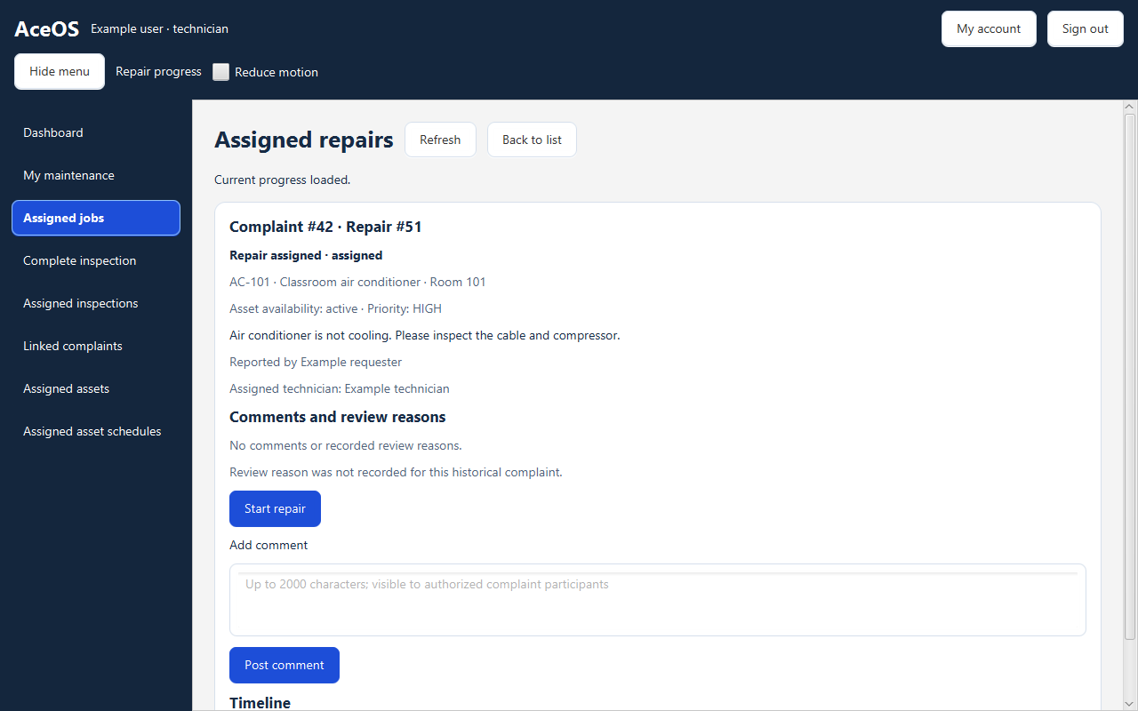
4. Start the assigned repair
08
Notes:
Timing: approximately 20 seconds. Point to the assigned technician, the repair status and Start repair. This is the technician view of the same example AC complaint and repair identifiers. The technician starts the repair and later submits completion evidence. This screenshot specifically shows the start action, not successful completion. Source: target/ui-checks/phase3-detail-technician-1280.png.
Sources: AceOS v2.0.0, https://github.com/SmitHitnalli/aceos ; README.md; docs/college-scope.md; docs/oop-design.md; docs/data-dictionary.md; docs/transactions.md; docs/verification.md. Source references below are repository-relative. Screenshots are controlled UI-check fixtures, not live institutional data.

Slide 9
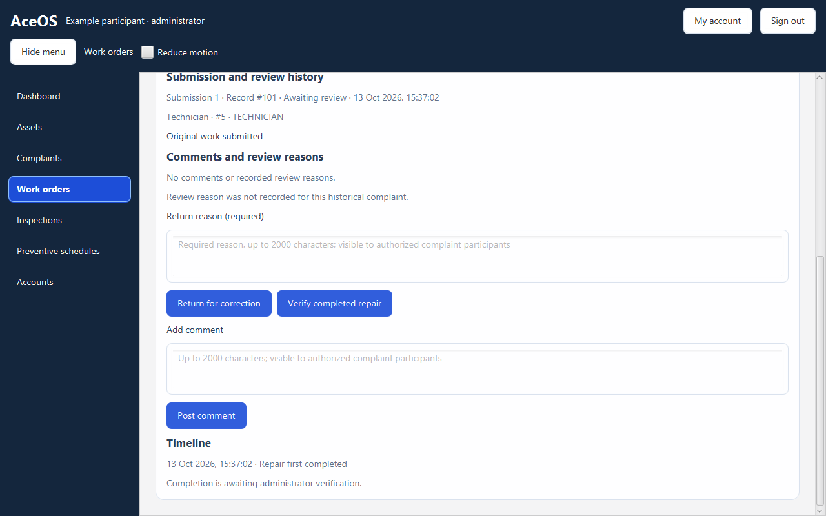
5. Verify the completed repair
09
Notes:
Timing: approximately 20 seconds. Point to the submitted work, the Verify completed repair control and the alternative Return for correction control. This screenshot shows the review controls before verification, not an already verified result. Verification accepts the latest displayed submission and resolves the linked complaint. Source: target/ui-checks/correction-shell-administrator-false-bottom-1280.png.
Sources: AceOS v2.0.0, https://github.com/SmitHitnalli/aceos ; README.md; docs/college-scope.md; docs/oop-design.md; docs/data-dictionary.md; docs/transactions.md; docs/verification.md. Source references below are repository-relative. Screenshots are controlled UI-check fixtures, not live institutional data.

Slide 10
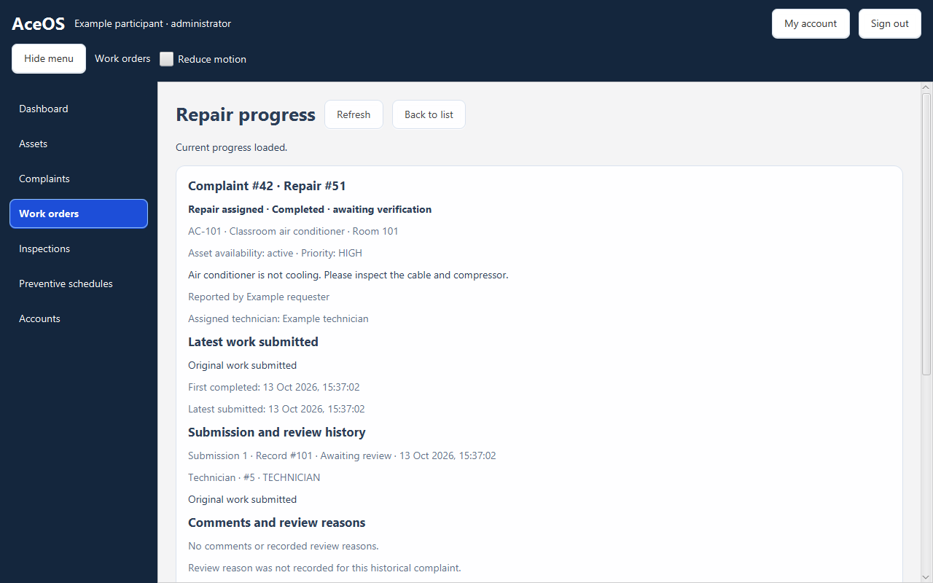
The repair record in AceOS
Current progress
Complaint, asset
and technician
Evidence history
Submitted work and
review reasons
10
Notes:
Timing: 55 seconds. This is an actual screenshot from the project’s controlled JavaFX checks. It shows the administrator’s repair-progress page for an example classroom AC complaint. Point first to the status, then the assigned technician, and finally the submission and review history. The interface separates the original complaint from the work submitted. Comments and review reasons are retained alongside the record. This screenshot is a fixture, not live campus information. If demonstrating the running app, show this same workflow here and keep the screenshot as a fallback. Source: target/ui-checks/correction-shell-administrator-false-top-1280.png.
Sources: AceOS v2.0.0, https://github.com/SmitHitnalli/aceos ; README.md; docs/college-scope.md; docs/oop-design.md; docs/data-dictionary.md; docs/transactions.md; docs/verification.md. Source references below are repository-relative. Screenshots are controlled UI-check fixtures, not live institutional data.

Slide 11
How the application is organised
JavaFX views
Services
Repositories
MySQL
→
→
→
Input and display
Rules and permissions
SQL through JDBC
Durable records
Java objects express behaviour.
Relational tables preserve the resulting facts and history.
11
Notes:
Timing: 45 seconds. A JavaFX view collects an action and calls AceOsService. The service validates the current session and coordinates the operation. Repositories issue SQL through JDBC to MySQL. Domain objects represent facts and selected lifecycle rules. The view therefore does not own SQL transactions, and the database does not decide which JavaFX screen is visible. FxTasks runs database operations in the background and returns interface updates to the JavaFX thread. This architecture connects the two course perspectives: object responsibilities on one side and durable relational data on the other.
Sources: AceOS v2.0.0, https://github.com/SmitHitnalli/aceos ; README.md; docs/college-scope.md; docs/oop-design.md; docs/data-dictionary.md; docs/transactions.md; docs/verification.md. Source references below are repository-relative. Screenshots are controlled UI-check fixtures, not live institutional data.

Slide 12
OOP: the main class relationships
Asset
←
Complaint
→
User
asset
reporter
↑
complaint
WorkOrder
→
User
technician
Roles are UserRole enum values; all three roles use the User class.
12
Notes:
Timing: 60 seconds. A Complaint references the Asset involved and the User who reported it. A WorkOrder references its Complaint and assigned technician. These are has-a associations: a work order is not a kind of user. UserRole distinguishes requester, technician and administrator without three User subclasses. That matches the implemented code and preserves identity when account responsibilities change. The diagram is simplified to the main domain classes. It does not imply that deleting an in-memory object deletes relational history. Source: src/main/java/com/aceos/model/Complaint.java, WorkOrder.java and User.java.
Sources: AceOS v2.0.0, https://github.com/SmitHitnalli/aceos ; README.md; docs/college-scope.md; docs/oop-design.md; docs/data-dictionary.md; docs/transactions.md; docs/verification.md. Source references below are repository-relative. Screenshots are controlled UI-check fixtures, not live institutional data.

Slide 13
OOP concepts in the implementation
Encapsulation
Inheritance
WorkOrder.start()
WorkspaceView extends BorderPane
Require ASSIGNED
Set IN_PROGRESS
Record startedAt
Polymorphism
JDBC objects implement Connection
Overloading
A guarded operation controls the state change.
User constructors with different arguments
13
Notes:
Timing: 70 seconds. Encapsulation is visible in WorkOrder.start: a caller requests a meaningful transition instead of assigning any status. The method requires ASSIGNED before recording IN_PROGRESS and a start time. Services still add authentication and persistent checks. Inheritance is present in the JavaFX UI: WorkspaceView extends BorderPane. Runtime polymorphism appears in JDBC Connection implementations and the transaction connection proxy. Constructor overloading is visible in User’s new-object and stored-object constructors. Do not claim a role subclass hierarchy. The snippet is shortened for explanation; the exact source includes requireStatus and its message. Sources: model/WorkOrder.java, model/User.java, ui/WorkspaceView.java and database/Transactions.java.
Sources: AceOS v2.0.0, https://github.com/SmitHitnalli/aceos ; README.md; docs/college-scope.md; docs/oop-design.md; docs/data-dictionary.md; docs/transactions.md; docs/verification.md. Source references below are repository-relative. Screenshots are controlled UI-check fixtures, not live institutional data.

Slide 14
RDBMS: the core relational design
assets
complaints
work_orders
→
→
PK asset_id
PK complaint_id
FK asset_id
PK work_order_id
FK + UQ complaint_id
1 : many
1 : 0..1
1 : many
repair_reviews
maintenance_records
←
←
PK review_id
FK + UQ maintenance_record_id
PK maintenance_record_id
FK work_order_id
1 : 0..1
PK: identity FK: reference UQ: unique
Simplified view • 5 of 16 tables • actor and evidence-pointer links omitted
14
Notes:
Timing: 65 seconds. The complete schema has 16 tables; this diagram isolates five central tables so the relationships are readable. One asset can have many complaints. A complaint can have zero or one work order. A work order can have many numbered maintenance submissions, and one submission can have zero or one terminal review. complaint_id is unique in work_orders, and the work-order/submission-number pair is unique in maintenance_records. The current and verified pointers use composite foreign keys to require evidence from the same work order. Actor, account, inspection and safety tables are omitted here, not absent from the system. Sources: docs/data-dictionary.md and docs/er-diagram.md.
Sources: AceOS v2.0.0, https://github.com/SmitHitnalli/aceos ; README.md; docs/college-scope.md; docs/oop-design.md; docs/data-dictionary.md; docs/transactions.md; docs/verification.md. Source references below are repository-relative. Screenshots are controlled UI-check fixtures, not live institutional data.

Slide 15
RDBMS: accepting one exact submission
Submission 1
One transaction
Returned with a reason
Record review
Verify exact submission
Resolve linked complaint
Recalculate availability + audit
Submission 2
New correction, new evidence
Separate tables reduce repeated facts.
Commit everything or roll back everything
15
Notes:
Timing: 70 seconds. Imagine submission one was returned and the technician created submission two. An old screen must not approve submission two merely because the status says COMPLETED again. Verification therefore compares the exact submission the administrator viewed. The service transaction inserts the VERIFY review, marks the work verified, resolves its complaint, recalculates availability and appends an audit event. If any write fails before commit, the operation rolls back. Keys preserve references; separation of assets, complaints and submissions reduces repeated facts. Availability and historical author snapshots are deliberate stored values. Verifying this repair does not automatically clear another repair or an independent safety hold. Source: docs/transactions.md.
Sources: AceOS v2.0.0, https://github.com/SmitHitnalli/aceos ; README.md; docs/college-scope.md; docs/oop-design.md; docs/data-dictionary.md; docs/transactions.md; docs/verification.md. Source references below are repository-relative. Screenshots are controlled UI-check fixtures, not live institutional data.

Slide 16
Verification and project results
46
3
40
Database
Password / session
JavaFX
89 recorded checks passed
Zero failures, errors or skips in the final v2.0.0 run
16
Notes:
Timing: 45 seconds. The final documented v2.0.0 run passed 89 configured checks: 46 database, 3 password/session and 40 JavaFX, with zero failures, errors or skips. These are recorded project results, not a fresh test run for this presentation. Coverage includes state transitions, stale evidence, rollback, role permissions and interface recovery. Human walkthrough confirmation is separate from automated checks, and focused earlier runs overlap the final total. The result is a functioning local application with traceable complaint and repair history, rather than a claim of production-scale deployment. Source: docs/verification.md.
Sources: AceOS v2.0.0, https://github.com/SmitHitnalli/aceos ; README.md; docs/college-scope.md; docs/oop-design.md; docs/data-dictionary.md; docs/transactions.md; docs/verification.md. Source references below are repository-relative. Screenshots are controlled UI-check fixtures, not live institutional data.

Slide 17
Conclusion and future scope
A complete repair workflow,
with evidence that stays connected.
OOP
Clear responsibilities and guarded behaviour
RDBMS
Linked history and atomic state changes
Future: notifications, QR lookup and a shared server
17
Notes:
Timing: 40 seconds. AceOS demonstrates one complete operational workflow from complaint to verified repair. The OOP contribution is the separation of responsibilities and controlled lifecycle behaviour. The RDBMS contribution is linked history and consistent multi-record changes. The current application is designed for a trusted local environment. Notifications, QR-based lookup and a shared server with server-side authorization are future extensions, not implemented features. Close by saying: the key design decision is to keep the complaint, the submitted repair and the accepted evidence distinct, while connecting them through objects and database keys. Invite questions.
Sources: AceOS v2.0.0, https://github.com/SmitHitnalli/aceos ; README.md; docs/college-scope.md; docs/oop-design.md; docs/data-dictionary.md; docs/transactions.md; docs/verification.md. Source references below are repository-relative. Screenshots are controlled UI-check fixtures, not live institutional data.

